Slide 1
Advanced Skills in EAGLE (Intermediate)
Day 1: EAGLE

Slide 2

Safety Precautions

Slide 3
Outline
Introduction
installation
Using EAGLE
Exporting

Slide 4
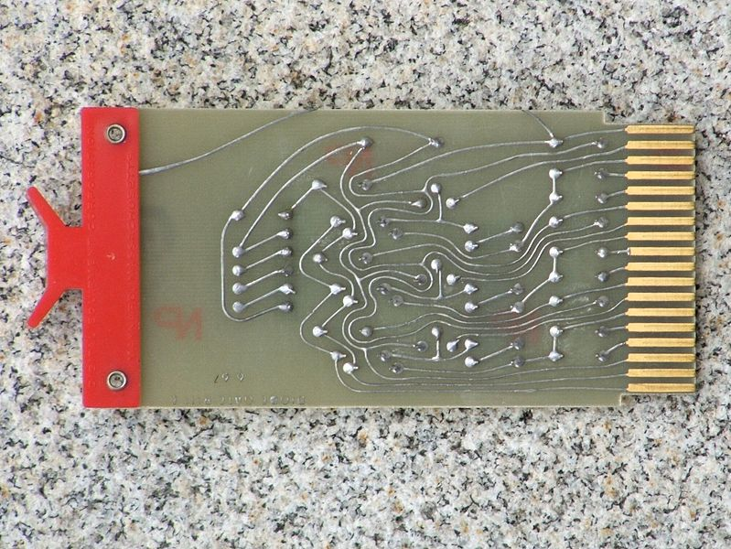
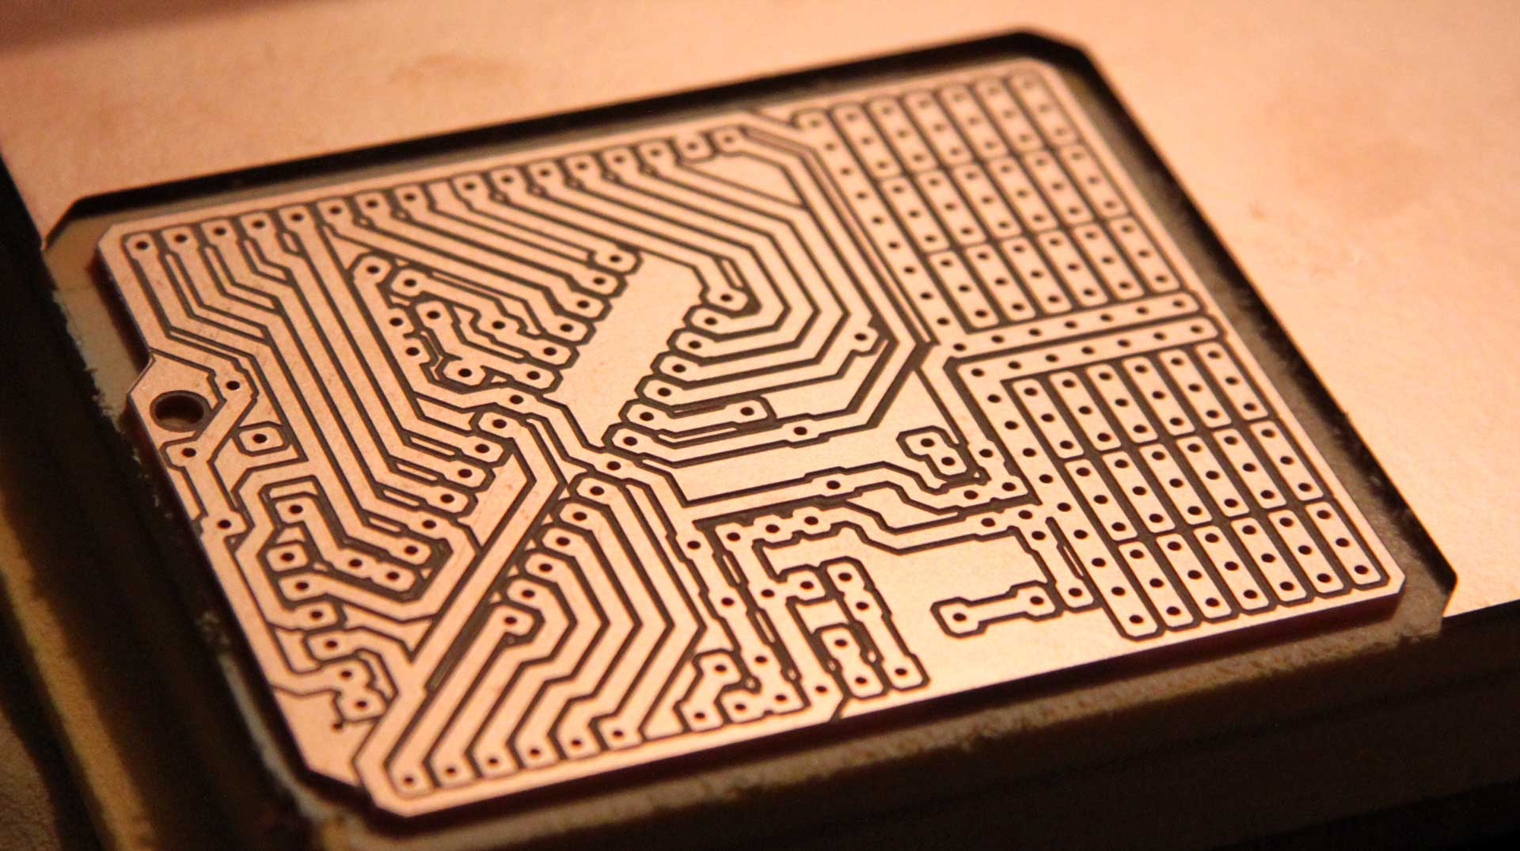
What is a PCB
1967
Printed Circuit Board
Connects components using copper
Can not cross connections

Slide 5
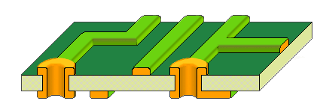
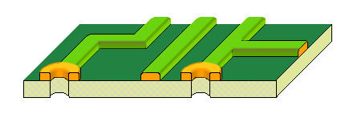
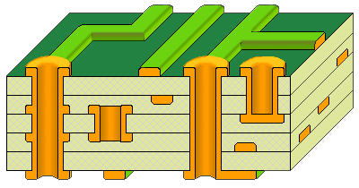
Kinds of PCBs
Single sided
Double sided
Multi-layered

Slide 6
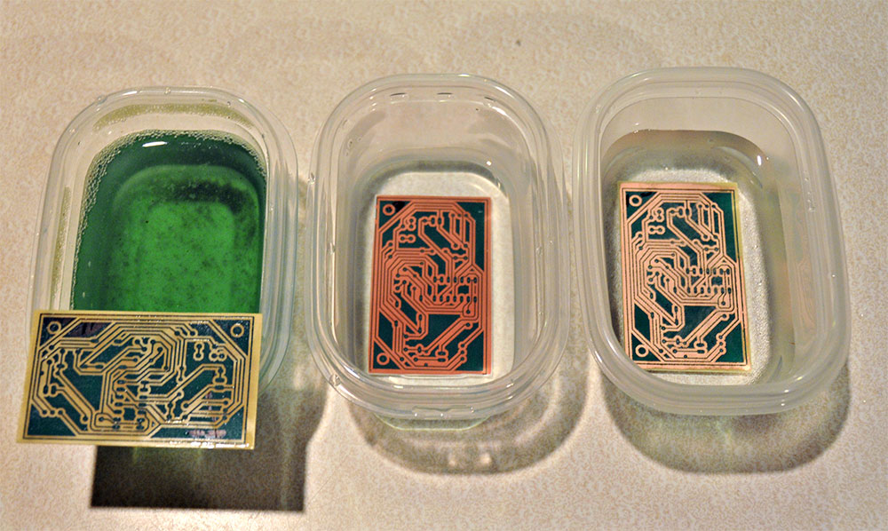
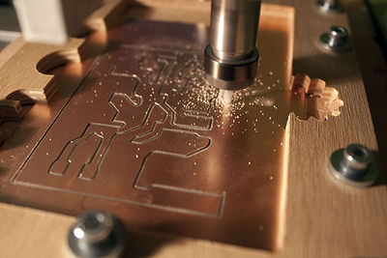
How to make them
Chemical etching
Milling (using CNC)

Slide 7

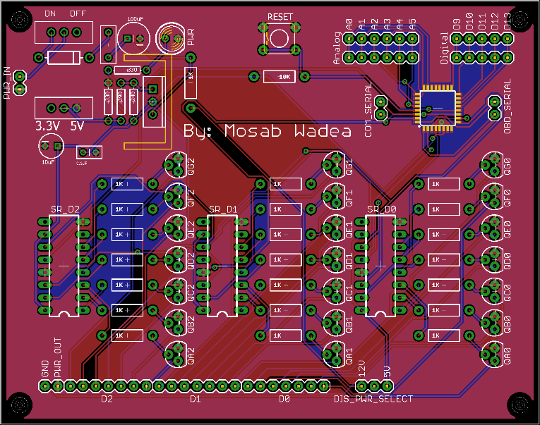
Drawing can be hard
CAD (Computer Aided Design)
EAGLE cad soft

Slide 8
LET’S DO IT NOW
Install
View control panel
Start drawing schematics
Convert to layout
DONE

Slide 9
Install EAGLE
Google
http://www.cadsoftusa.com/

Slide 10
Setup EAGLE
We have to add some libraries and scripts
https://github.com/sparkfun/SparkFun-Eagle-Libraries
Script and ulp
https://github.com/MosabWadea/EAGLE-custome_settings

Slide 11
Example
Paperduino
http://paperduino.eu/doku.php

Slide 12

ANY QUESTIONS??

Slide 13
My Contact Information
Name: Mosab Wadea
E-mail: mwaamh+fl@gmail.com
Find full course and tutorial at:
https://www.maharah.net/courses/inro2eagle/

